Slide 1
Bitcoin Sentiment Analysis
Seohong, Scott, Sara, Rupali

Slide 2
Hypothesis
Google search volumes for bitcoin on Google Trends will correlate positively with Bitcoin trading volumes and possibly Bitcoin price.
If Bitcoin related negative searches on Google rise relative to positive searches, Bitcoin price will trend down.

Slide 3
Data Sources
Google Trends
Positive and Negative sentiment
https://trends.google.com/trends/
CryptoCompare API
Price and Volume
https://min-api.cryptocompare.com/data/histoday

Slide 4
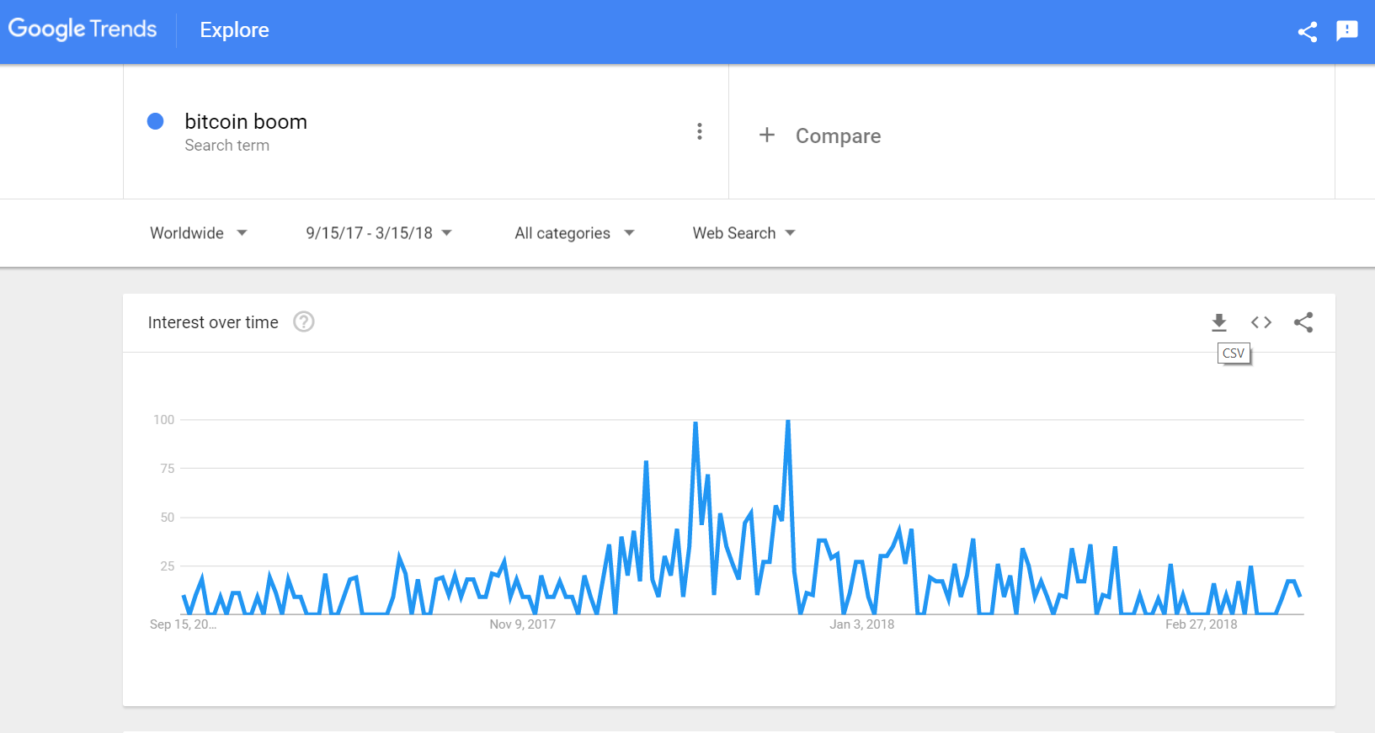
Data Exploration – Google Trends

Slide 5
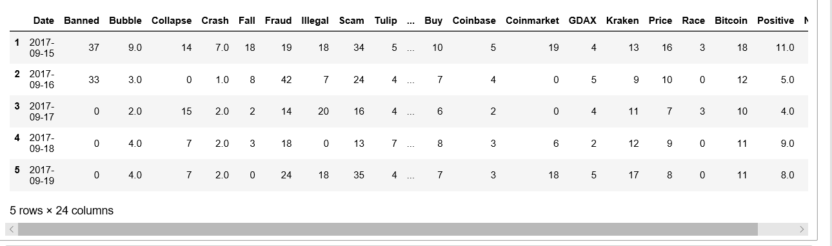
GoogleTrends Data Cleanup and Format

Slide 6
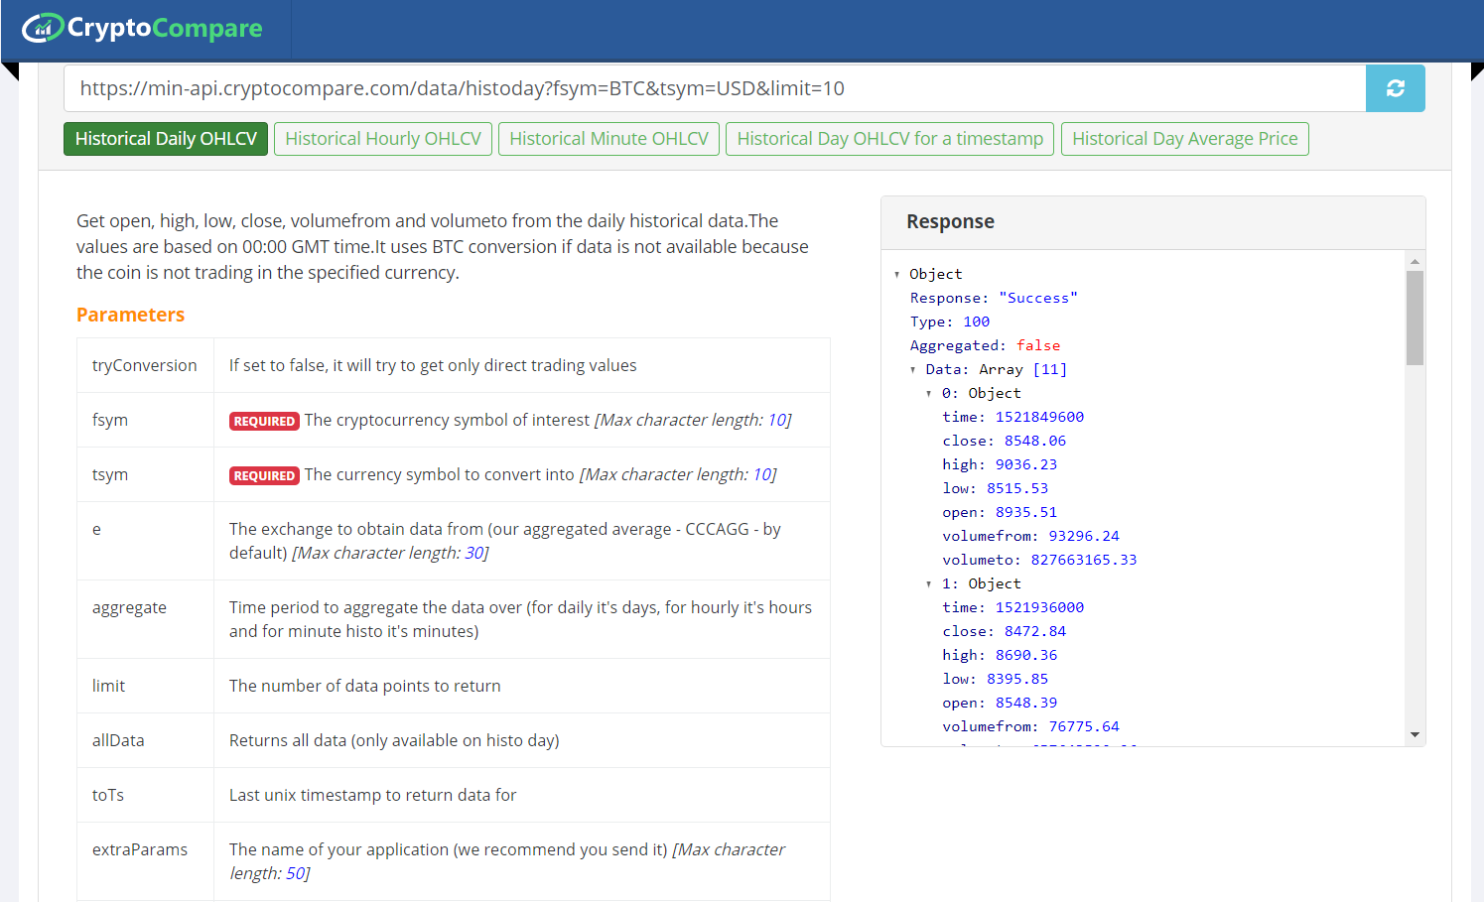
Data Exploration - CryptoCompare

Slide 7
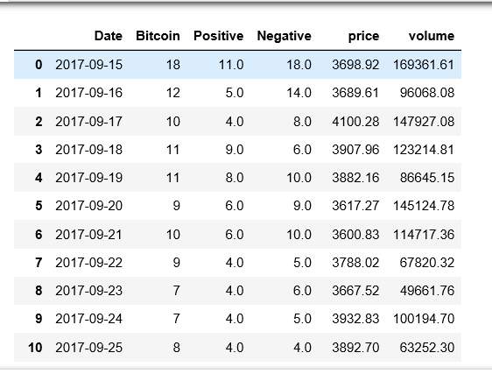
Final Dataset

Slide 8
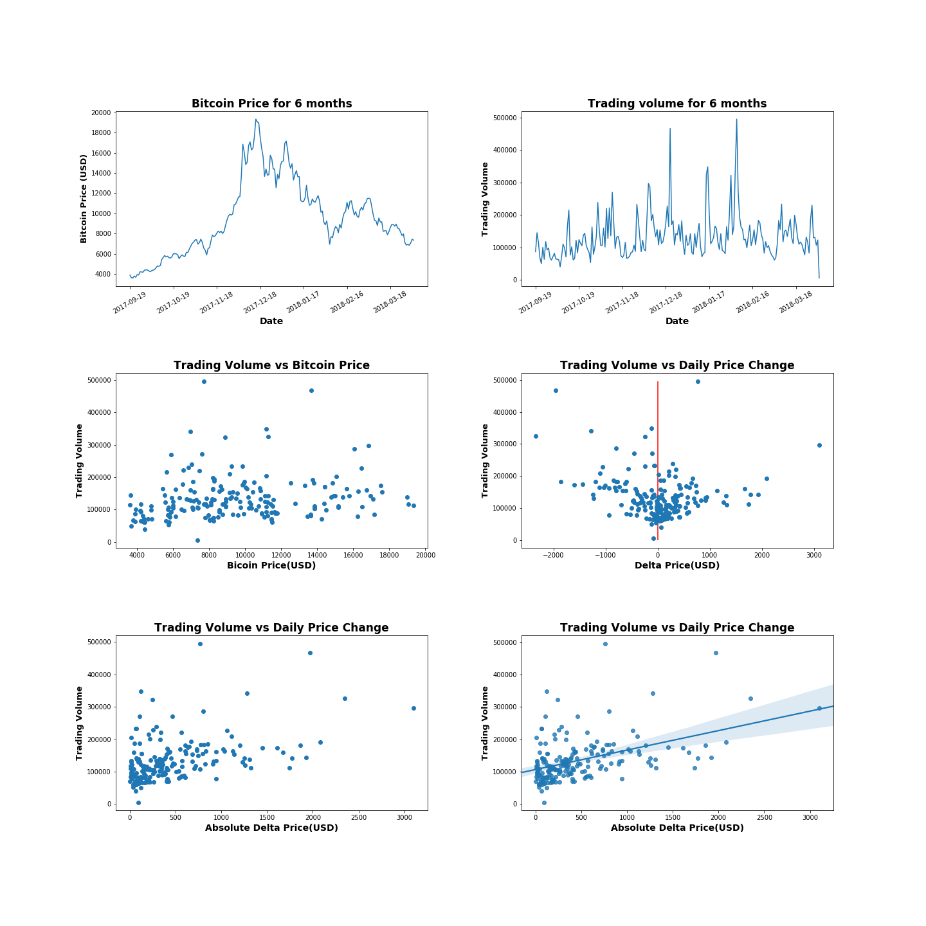
Bitcoin Trading Volume versus Price Analysis
Trading frequency was higher under $ 12,000 than over the value.
Most of the transactions (99.5% of Total Trading Volume) took place below $ 1,000 change per day.
The larger Bitcoin Price Change, the larger Trading Volume.

Slide 9
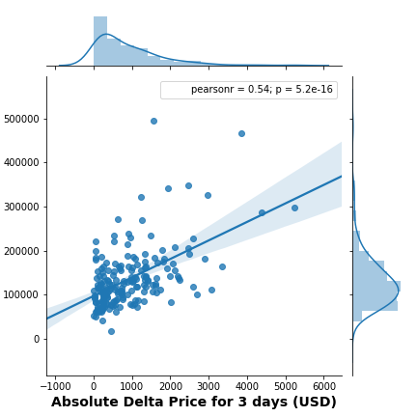
Bitcoin Daily Analysis
Looking at the change in the bit coin trading volume with the price change for one day to 7 days, The trading volume with the price change for 3 days has the greatest positive correlation. (r = 0.54, p = 5.2e-16)
Bitcoin trading tend to occur for three days against the bit coin price fluctuations.

Slide 10
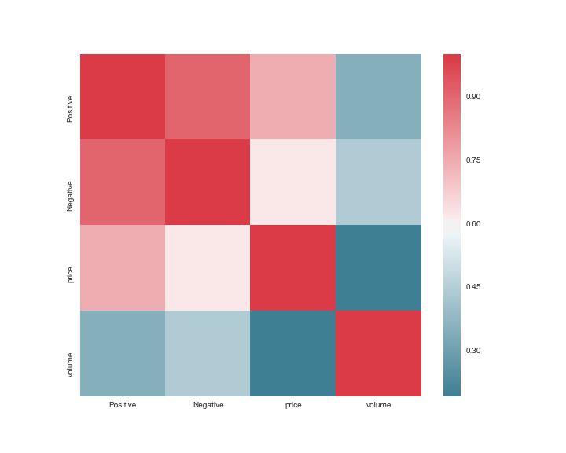
HeatMap

Slide 11
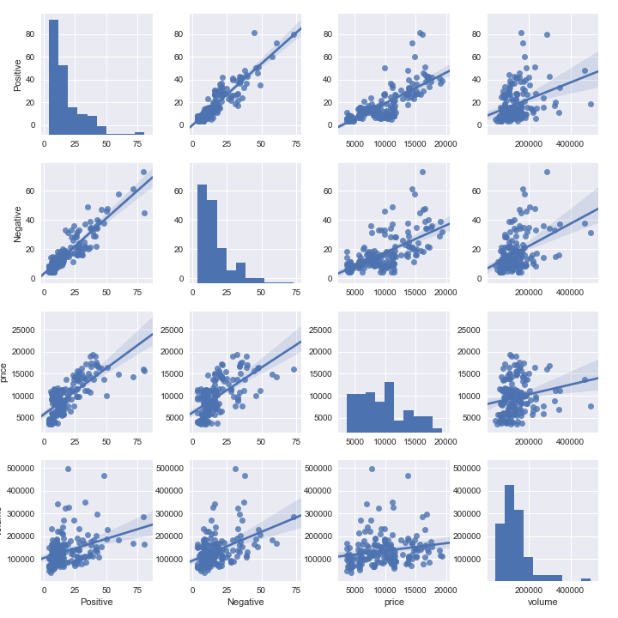

Slide 12
